Slide 1





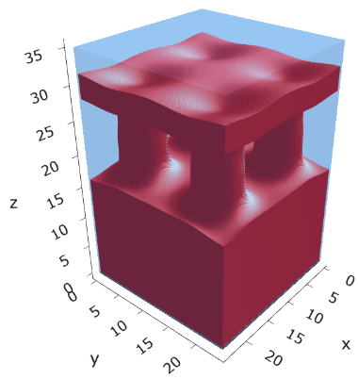
a040x170s020

Slide 2






a040x170s010

Slide 3


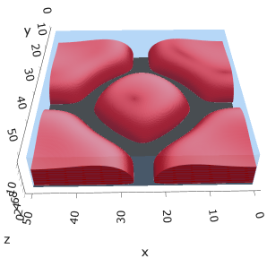
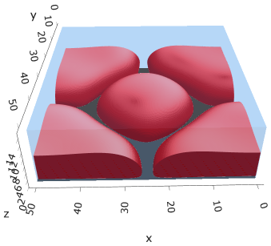

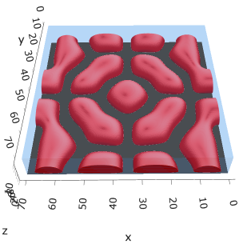
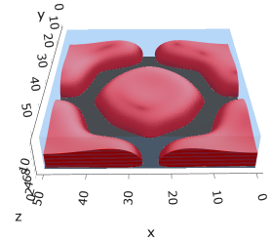

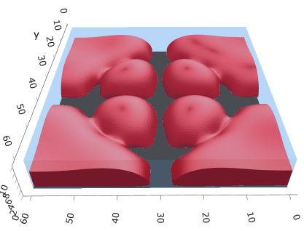
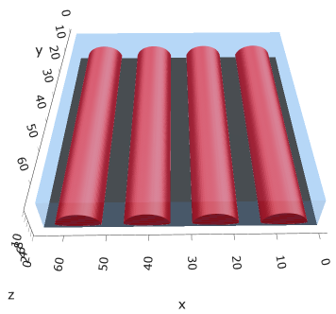
Micelle / Stripe / Cylinder
s = 5e-03, N = 50, a = 0.0, x = 1.0
s = 5e-03, N = 75, a = 0.0, x = 1.0
s = 5e-03, N = 105, a = 0.05, x = 1.0
s = 5e-03, N = 140 a = 0.10, x = 1.0
Isosurface at pha = 0.1

Slide 4

a040x170s025

Slide 5














a040x170s022

Slide 6










a040x170 seed
See if becomes hex
cyl4-975
cyl4-12
cyl16-975
cyl16-1025
cyl1

Slide 7






a040x170s017

Slide 8












































a040x170s015 seed
Almost done
Almost done

Slide 9

















a040x170s013

Slide 10
















a040x170s010 seed

Slide 11














X200 x170 x130 x120 x100
F = −10.24458
F = − 9.14301
F = −11.0057
F = −10.2429
F = −11.0015
F = −9.63949
F = −10.2461
F = −10.9948
F = − 9.63030
F = −10.2431
F = −10.9953

Slide 12





a040x100 relaxation

Slide 13








































a040x100 seed
old
old

Slide 14


a040x120 relaxation
F = −10.24458

Slide 15





































a040x120 seed
cyl16-850
cyl16-825

Slide 16






a040x130 relaxation

Slide 17




a040x170 relaxation
F = −9.10347
1 neck

Slide 18







a040x200 relaxation

Slide 19










a040x200 seed
Note: not completely converged but stopped for resources

Slide 20


a0.40 x1.70

Slide 21





Zhulina JCP 1998
a = 0.01
0.1 mM
1 mM
May need to init using sine
10 mM
25 mM
Zhulina NVT; current GCE runs at Lz = 20

Slide 22

Carrillo Langmuir 2009

Slide 23

Parallelization

Slide 24
Equations
Quenched average, np, A --> \inf ; np/A → \sigma
Discrete Gaussian chain

Slide 25




Scaling (Alexander—de Gennes brush)
V = 4.2; H = 27.5 – 30.5
V = 2; H = 39 – 45.5

Slide 26






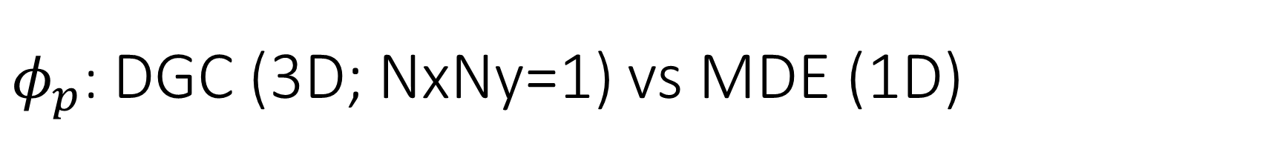
$φ_{p}$: DGC (3D; NxNy=1) vs MDE (1D)
Ns/sigs: dz = 0.10, Ngz_2 = 4$σ$; Chis/bs: dz = 0.25, Ngz_2 = 3.5$σ$

Slide 27


Numericals
Ys
Possibly do Ngz for multiple dzs

Slide 28








3D
Lxy = 1
Lxy = 10
Lxy = 5
Lxy = 15
y-z heatmaps for $φ_{p}$ at constant x

Slide 29





z-FFT vs z-FD (MDE) – REDFT01 xy(z)
Lx = 5, Ly = 5, Lz = 50. s = 0.02. x = 0.75. a = 0.00, N = 50
3D vs 1D (dashed): dz = 0.5, ds = 0.20; dz_1D = 0.113, ds_1D = 0.083
FFT (xyz)
FFT (yz vs pha)
FD (xyz)
FD (yz vs pha)
Diff btw 1D/3D should just be dz, ds, etc.

Slide 30
Specifying Grafted Points

Slide 31
Strategy
2D binary array for surface sites of homogeneously grafted polymer given grafting density, simulation box size, and discretization (and assuming dx = dy)
Fullspace must be periodic on x0 = xL, y0 = yL
Halfspace must be even on xL/2 and yL/2 (overlap of boundary following REDFT00) and periodic on x0 = xL, y0 = yL.
Homogeneous spacing as determined by regular hexagon, where grafting point at centroid of hexagon
In case there are edge effects, try shifting the centroids away from the boundaries of the xy-plane (only did for fullspace)
Make sure no edge effects by comparing results of full FFT with cos FFT

Slide 32
Test conditions
Sigma = 0.05 c/nm2
Lx = 15 nm
Ly = 15 nm
dx = 0.4 nm
Cast in terms of dx (for rounding and PBC for grafting points):
Sigma = 0.0668 c/nm2
Lx = 14.80 nm
Ly = 11.20 nm
(Sigma error decrease with dx)

Slide 33

Padded PBC (Full FFT)
Hexagons drawn for illustration of hexagon approach

Slide 34

Unpadded PBC (Full/Cos FFT)

Slide 35






Other conditions (full and half results overlapped to show match)
s = 0.0241 (20.28%; dx=0.4), Lx, Ly = 12.40, 20.80
s = 0.0208 (4.08%; dx=0.1), Lx, Ly = 12.90, 22.30
s = 0.1332 (11%; dx=0.1), Lx, Ly = 20.50, 20.40

Slide 36


